Slide 1

Generative AI and its Applications
BERT and GPT
Dr. Pooja Agarwal
Department of Computer Science and Engineering

Slide 2

Generative AI and its Applications
(UE23CS342BA4)
We have covered:
LLM Basics and evolution
NLP: Word Embeddings
POS and NER
Text Classification
We will now cover:-
ELMo, Transformer Anatomy,
BERT,GPT, ROBERTa, BART architectures

Slide 3
Generative AI and its Applications
(UE22CS342BA9)
Transformers (2017): Introduced the fundamental architecture for LLMs.
ELMo (2018): Leveraged context-sensitive embeddings using bi-directional LSTMs.
GPT (2018): Built on transformer architecture for text generation.
BERT (2018): Utilized transformers bidirectionally for better context understanding.
RoBERTa (2019): Enhanced BERT with optimized training methods.
BART (2019): Combined encoder-decoder frameworks from BERT and GPT.

Slide 4
Generative AI and its Applications
(UE22CS342BA9)
BERT
Dr. Pooja Agarwal
Department of Computer Science and Engineering

Slide 5
Generative AI and its Applications
BERT: What Challenges Does BERT Help to Solve?
The Problem with Words
The problem with words is that they’re everywhere. More and more content is out there.
Words are problematic because plenty of them are ambiguous, polysemous, and synonymous.
BERT is designed to help solve ambiguous sentences and phrases that are made up of lots and lots of words with multiple meanings.

Slide 6
Generative AI and its Applications
BERT: What Challenges Does BERT Help to Solve?
Ambiguity & Polysemy
Almost every other word in the English language has multiple meanings. In spoken word, it is even worse because of homophones and prosody.
For instance, “four candles” and “fork handles” for those with an English accent. Another example: comedians’ jokes are mostly based on the play on words because words are very easy to misinterpret.
It’s not very challenging for us because we have common sense and context so we can understand all the other words that surround the context of the situation or the conversation – but search engines and machines don’t.
This does not bode well for conversational search into the future.

Slide 7
Generative AI and its Applications
BERT
Eg.
“I like the way that looks like the other one.”
By Stanford Part-of-Speech Tagger , “like” is considered to be two separate parts of speech (POS).
The word “like” may be used as different parts of speech including verb, noun, and adjective.
So literally, the word “like” has no meaning because it can mean whatever surrounds it.
The context of “like” changes according to the meanings of the words that surround it.
The longer the sentence is, the harder it is to keep track of all the different parts of speech within the sentence.

Slide 8
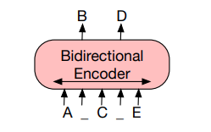

Generative AI and its Applications
BERT
Bidirectional Encoder Representations from Transformers
BERT utilizes the encoder component of the Transformer architecture, which allows it to process text in bidirectional manner.
Unlike traditional models that read text either left-to-right or right-to-left, BERT analyzes text from both directions simultaneously. This bidirectional approach enables BERT to grasp context more effectively and accurately understand language nuances.
Introduced by Google AI in October 2018

Slide 9
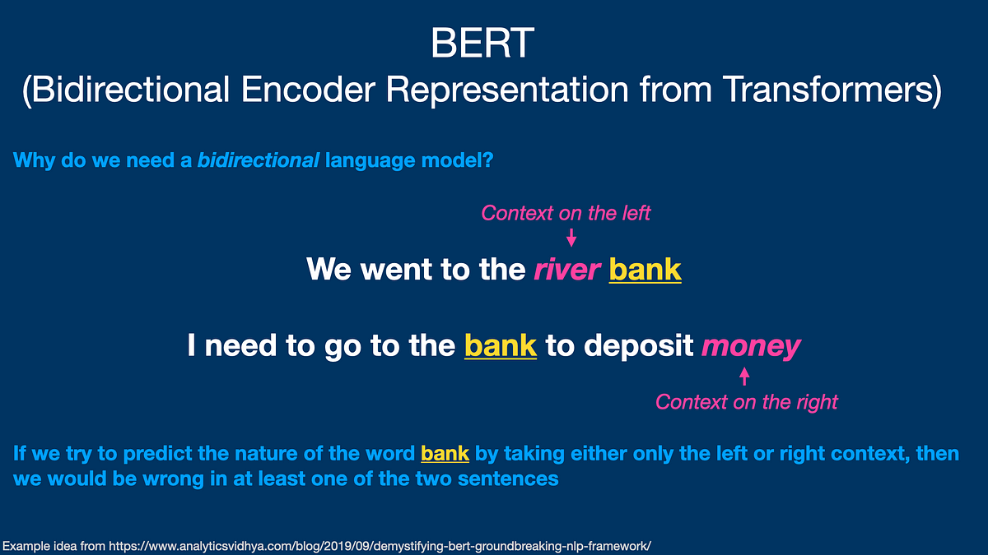
Generative AI and its Applications
BERT
Bidirectional Encoder Representations from Transformers
Example: In "The bank is by the river"
Understands "bank" using both:
Previous words: "The"
Following words: "is by the river"

Slide 10
Generative AI and its Applications
BERT
Architecture
BERT uses an encoder-only transformer architecture consisting of four key modules:
A tokenizer that converts text into integer sequences.
An embedding layer that transforms tokens into vectors embeddings.
A transformer encoder stack with self-attention.
A task head that produces probability distributions over tokens.

Slide 11
Generative AI and its Applications
BERT : Overview
BERT has been
pre-trained on Wikipedia,
it is fine-tuned on questions and answers datasets.
Researchers also compete over Natural Language Understanding with SQuAD (Stanford Question Answering Dataset).
BERT now even beats the human reasoning benchmark on SQuAD.
Strengths: Excellent at understanding context, bidirectional representation, strong performance on various NLP tasks.
Weaknesses: Not designed for text generation, limited to understanding tasks.

Slide 12
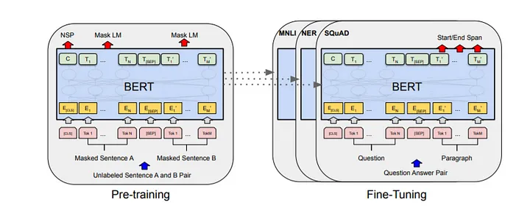
Generative AI and its Applications
BERT
Encoder transformers are trained on huge datasets to capture semantics and linguistic contexts from them. Pre-training BERT uses two unsupervised tasks, that are Masked LM and Next Sentence Prediction (NSP) to train.
1. Masked Language Model
2. Next Sentence Prediction

Slide 13
Generative AI and its Applications
BERT
Masked Language Modeling (MLM) Think of this like a sophisticated version of fill-in-the-blanks. For example:
Original: "The cat sits on the mat"
Masked: "The [MASK] sits on the mat“
BERT looks at all words (before and after the mask) to figure out what word should go in the blank.
The training data generator chooses 15% of the token positions at random for prediction. If the iᵗʰ token is chosen, we replace the iᵗʰ token with
1.The [MASK] token 80% of the time 2. A random token 10% of the time 3. The unchanged iᵗʰ token 10% of the time
It learns to predict the original word by understanding the entire context

Slide 14
Generative AI and its Applications
BERT
Next Sentence Prediction (NSP) This is like teaching BERT to understand if two sentences naturally follow each other. For instance:
Sentence A: "I love ice cream"
Sentence B: "It's my favorite dessert" (This naturally follows) vs.
Sentence B: "The car needs gas" (This doesn't follow)
BERT learns to predict whether sentence B truly follows sentence A in the original text or if it is a random sentence. Many important downstream tasks such as Question Answering (QA) are based on the relationship between two sentences. Training a binary classifier for telling whether one sentence is the next sentence of the other, this pre-training will improve efficiency in tasks like QA and NLI.

Slide 15
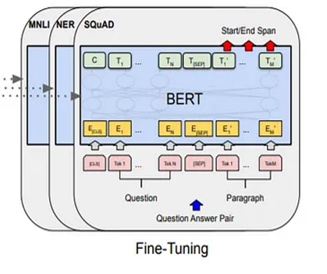
Generative AI and its Applications
BERT
Fine-tuning: Teaching BERT New Tasks
After BERT learns language generally, it can be fine-tuned for specific tasks( downstream tasks), like:
Understanding if a movie review is positive or negative: Sentiment Analysis
Finding answers in a text
Identifying names and places in sentences: NER
This is like taking a well-educated student (pre-trained BERT) and giving them specialized training for a specific job.

Slide 16
Generative AI and its Applications
BERT

Slide 17
Generative AI and its Applications
BERT
BERT's Input Processing
BERT processes text in a special way:
Every word gets three types of information:
The word itself (Token Embedding)
Which sentence it belongs to (Segment Embedding)
Where it appears in the sentence (Position Embedding)
The token embeddings are passed through BERT's multiple layers of bidirectional transformers. Each layer refines the embeddings by capturing the context from both directions (left-to-right and right-to-left).

Slide 18
Generative AI and its Applications
BERT
BERT's Input Processing
Special markers are used:
[CLS] at the start (like raising a flag saying "pay attention, new text coming")
[SEP] between sentences (like a boundary marker)
[MASK] for hidden words during training

Slide 19
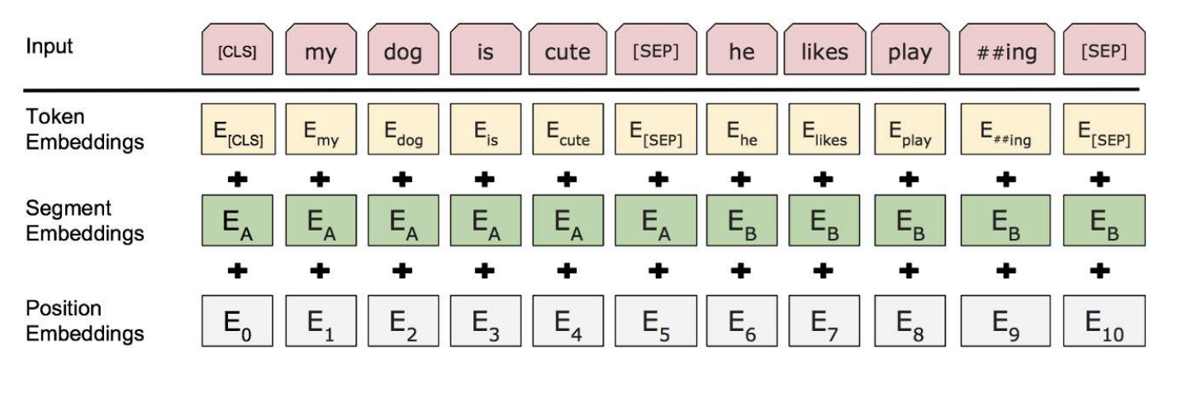
Generative AI and its Applications
Model Input Output Representation
The first token in each sequence is always a [CLS] token that is used in classification.
● Separating Sentences apart can be done in two steps:
○ Separate between sentences using [SEP] token,
○ Adding a learned embedding to each token in order to state which sentence it belongs to.
Each token is represented by summing the corresponding token, segment and position embedding as seen in the figure
https://medium.com/@_init_/why-bert-has-3-embedding-layers-and-their-implementation-details-9c261108e28a

Slide 20
Generative AI and its Applications
BERT – EXAMPLE 1
Example - Workflow for Text Classification
Tokenization: Convert the input text "I love this movie!" into tokens: [CLS], I, love, this, movie, !, [SEP].
Embedding: Generate embeddings for each token.
Contextualization: Pass the embeddings through BERT's transformer layers to get contextual embeddings.
[CLS] Token: Extract the final hidden state of the [CLS] token.
Classification: Pass the [CLS] token's hidden state through the classification layer to get the class probabilities (e.g., positive or negative sentiment).

Slide 21
Generative AI and its Applications
BERT - EXAMPLE 2
Using BERT for Question Answering
The question and the context (passage) are concatenated into a single input sequence. Special tokens [CLS] and [SEP] are used to separate the question and the context.

Slide 22
Generative AI and its Applications
BERT – Example QA
Context: "BERT is a transformer-based model developed by Google. It is designed to understand the context of words in a sentence."
Question: "Who developed BERT?"
Steps:
Input Representation:
Combined sequence: [CLS] Who developed BERT? [SEP] BERT is a transformer-based model developed by Google. It is designed to understand the context of words in a sentence. [SEP]
Tokenization:
Tokens: [CLS], Who, developed, BERT, ?, [SEP], BERT, is, a, transformer, -, based, model, developed, by, Google, ., It, is, designed, to, understand, the, context, of, words, in, a, sentence, ., [SEP]
Contextual Embeddings:
The token embeddings are passed through BERT's layers to generate contextual embeddings.

Slide 23
Generative AI and its Applications
BERT
4. Output Layers:
Start Token Classifier: Predicts the start position of the answer. In this case, it might predict the position corresponding to the token Google.
End Token Classifier: Predicts the end position of the answer. In this case, it might predict the position corresponding to the token Google.
5. Fine-Tuning:
The model is fine-tuned on a dataset where the start and end positions of the answer are labeled. For this example, the start and end positions would both point to the token Google.
Result
Predicted Answer: "Google“

Slide 24
Generative AI and its Applications
BERT – EXAMPLE 3
Imagine you have a large document about climate change, and you want to verify the answer to the question "What are the main causes of climate change?" You might already have an answer like "Greenhouse gas emissions and deforestation," but you want to ensure this answer is accurately reflected in the document.
Context: "Climate change is primarily driven by human activities, including the burning of fossil fuels, which releases greenhouse gases into the atmosphere, and deforestation, which reduces the number of trees that can absorb carbon dioxide."
Question: "What are the main causes of climate change?"
Proposed Answer: "Greenhouse gas emissions and deforestation."

Slide 25
Generative AI and its Applications
BERT
Using BERT, you can:
Tokenize the question and context.
Generate embeddings for the tokens.
Predict the start and end positions of the answer in the context.
Extract and validate the answer from the context.
Application: Answer Validation, Contextual Relevance, QA Systems from doc repository, Edu tools

Slide 26
Generative AI and its Applications
BERT
BERT is trained on huge corpus i.e. English Wikipedia (2,500M words) and BooksCorpus (800M words) which makes it a state-of-the-art model.

Slide 27
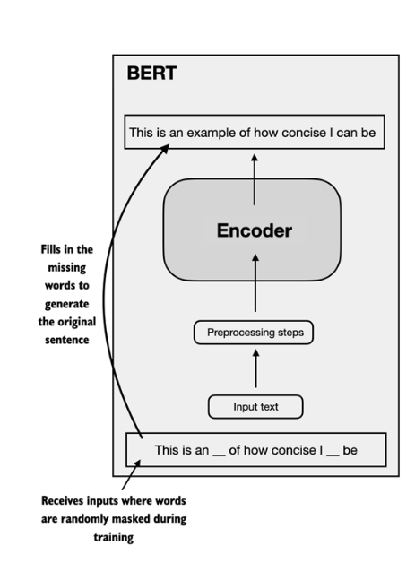
Generative AI and its Applications
BERT
References:
Book: Build a Large Language Model (From Scratch)

Slide 28
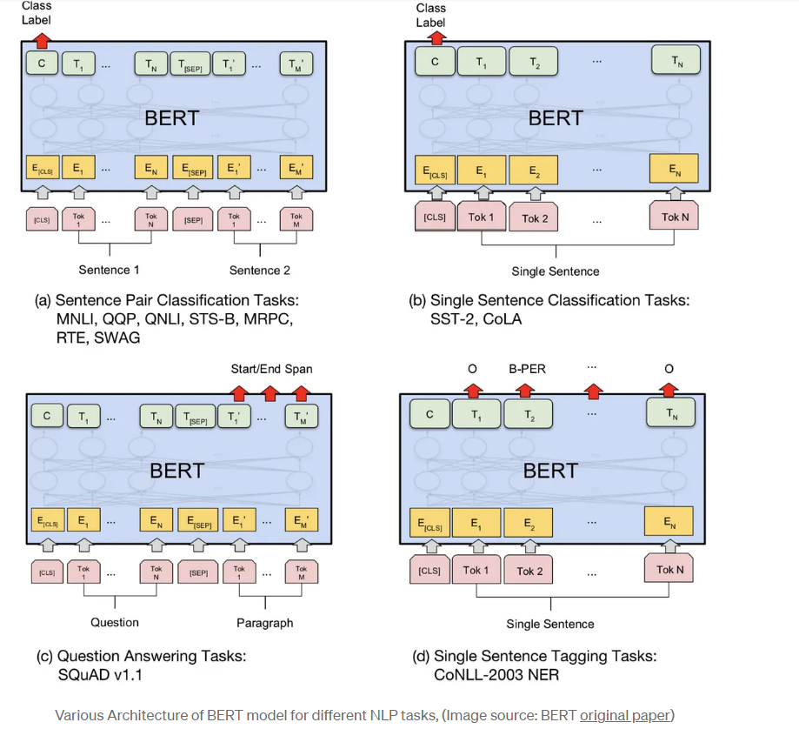
Various Architecture of BERT Model
BERT
References:
Book: Build a Large Language Model (From Scratch)

Slide 29
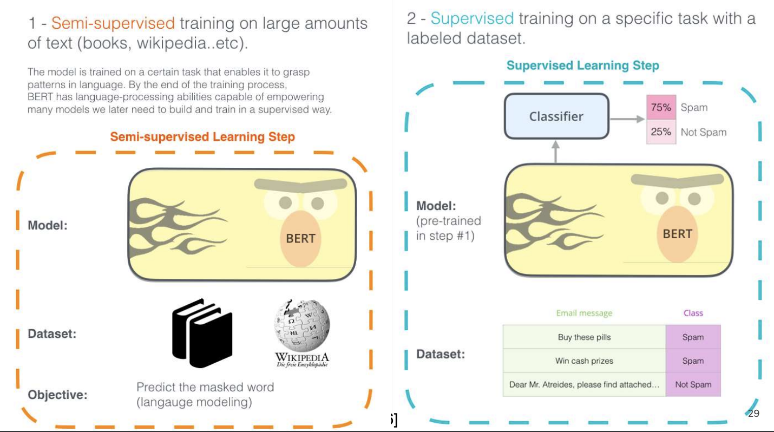
Generative AI and its Applications
BERT – EXAMPLE 4
BERT almost have the same model architecture across different tasks with small changes between the pre-trained architecture and the final downstream architecture

Slide 30
Generative AI and its Applications
BERT
Lots of the major AI companies are also building BERT versions:
Microsoft extends on BERT with MT-DNN (Multi-Task Deep Neural Network).
RoBERTa from Facebook.

Slide 31
Generative AI and its Applications
(UE22CS342BA9)
GPT
Dr. Pooja Agarwal
Department of Computer Science and Engineering

Slide 32

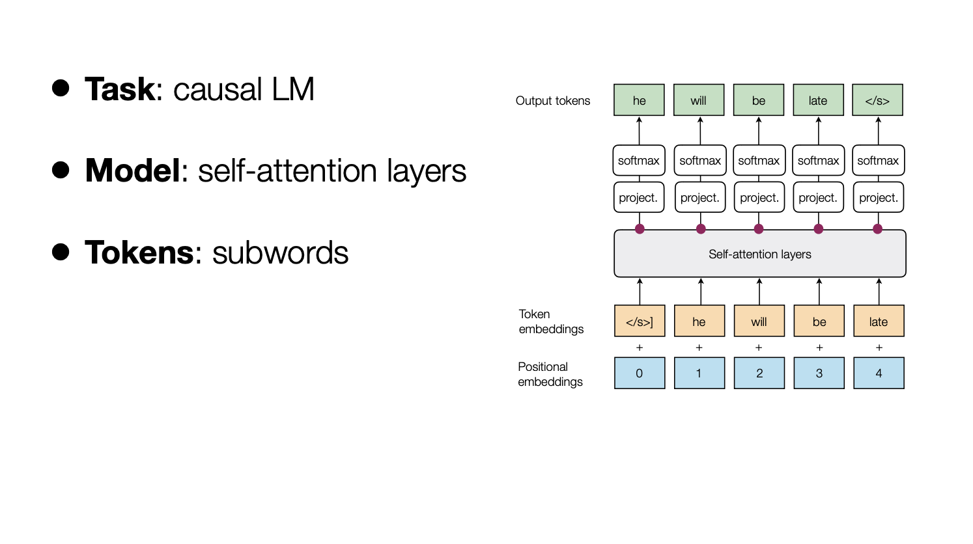
NATURAL LANGUAGE PROCESSING
GPT(Generative Pre-training Transformer)

Slide 33
NATURAL LANGUAGE PROCESSING
GPT(Generative Pre-training Transformer)
Following the similar idea of ELMo, OpenAI GPT (Radford et al., 2018), expands the unsupervised language model to a much larger scale by training on a giant collection of free text corpora.
Despite of the similarity, GPT has two major differences from ELMo.
The model architectures are different: ELMo uses a shallow concatenation of independently trained left-to-right and right-to-left multi-layer LSTMs, while GPT is a multi-layer transformer decoder.
The use of contextualized embeddings in downstream tasks are different: ELMo feeds embeddings into models customized for specific tasks as additional features, while GPT fine-tunes the same base model for all end tasks.

Slide 34
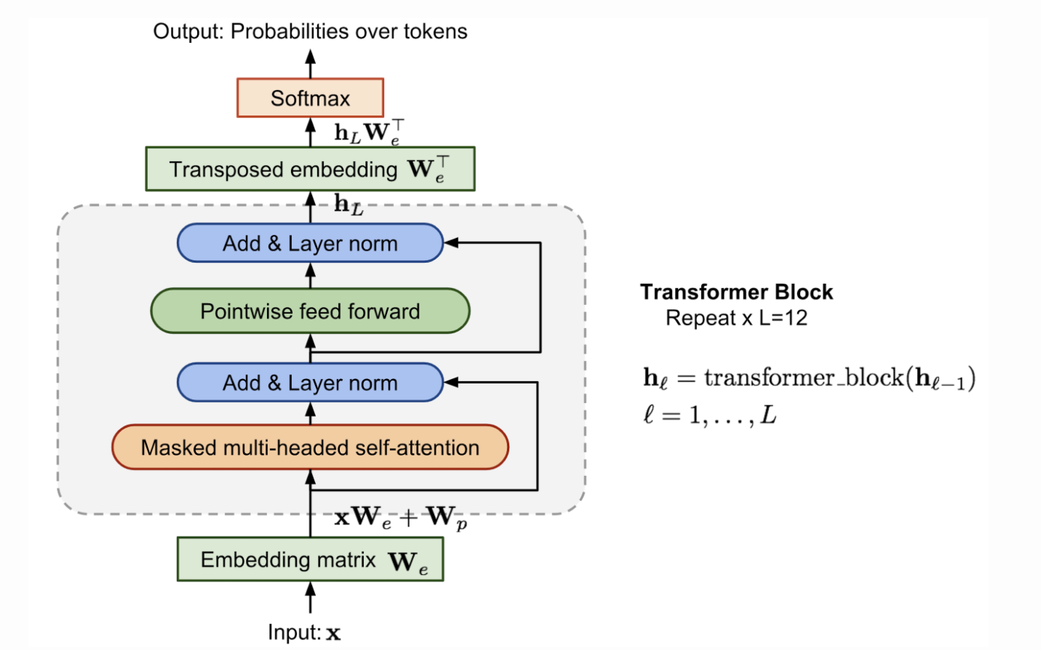
NATURAL LANGUAGE PROCESSING
GPT(Generative Pre-training Transformer)
Compared to the original transformer architecture, the transformer decoder model discards the encoder part, so there is only one single input sentence rather than two separate source and target sequences.
This model applies multiple transformer blocks over the embeddings of input sequences.
Each block contains a masked multi-headed self-attention layer and a pointwise feed-forward layer.
The final output produces a distribution over target tokens after softmax normalization.

Slide 35
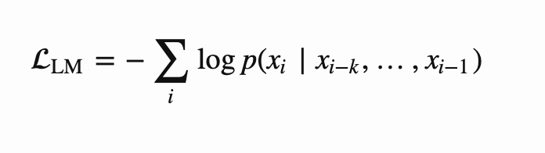
NATURAL LANGUAGE PROCESSING
GPT(Generative Pre-training Transformer)
The loss is the negative log-likelihood, same as ELMo, but without backward computation.
Let’s say, the context window of the size k is located before the target word and the loss would be:

Slide 36
GPT(Generative Pre-training Transformer) – DECODER BASED MODEL
The Encoder Transformer are great at capturing the contexts in sequences. BUT they can not generate the sequences of texts.
Decoder based models are trained to generate coherent and contextually relevant text by autoregressively predicting the next word or token based on the preceding ones.
Some of the most common decoder-based models are GPT-2 and GPT-3 proposed by OpenAI.
GPT is trained on the Boookcorpus 500 M words.

Slide 37
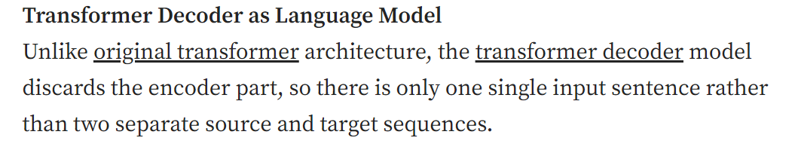
GPT(Generative Pre-training Transformer)

Slide 38
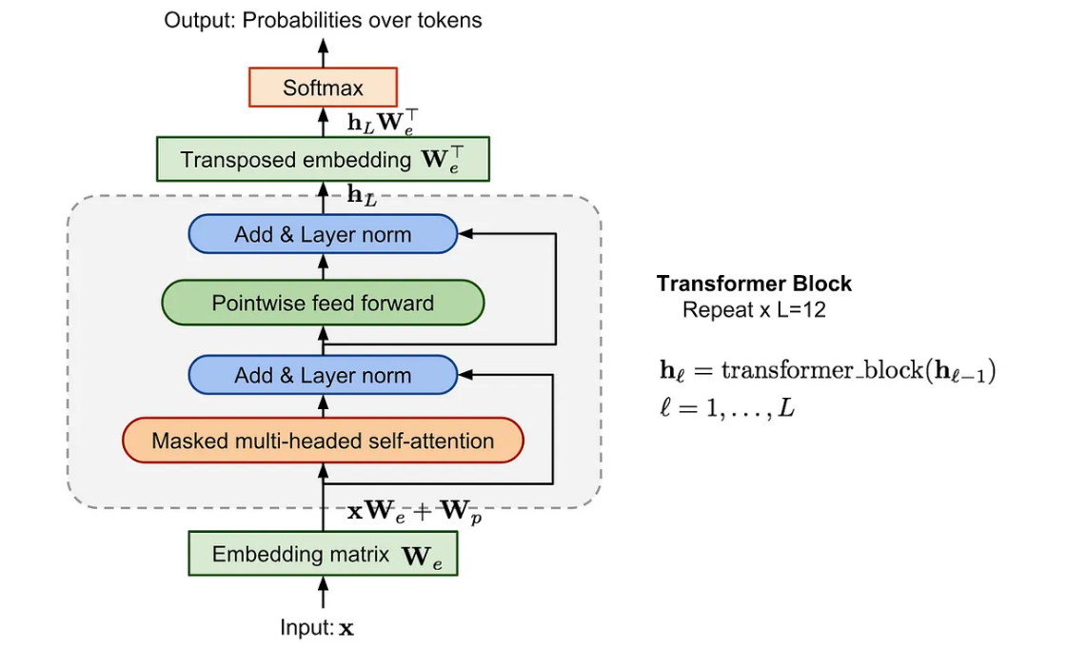
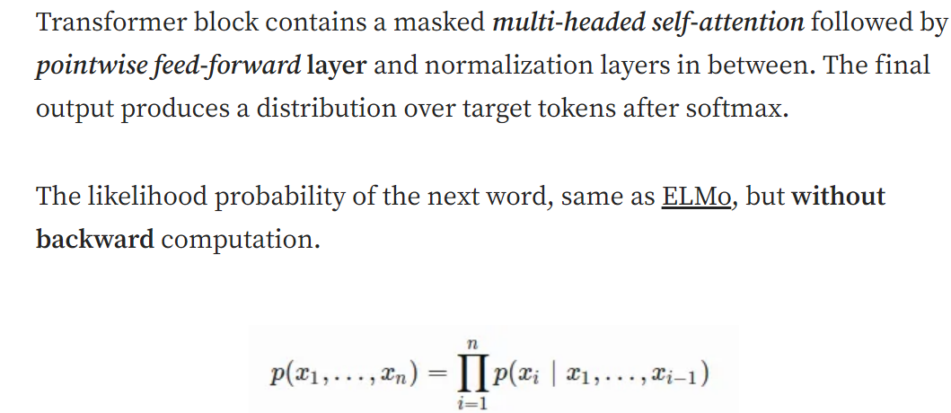
GPT(Generative Pre-training Transformer)

Slide 39
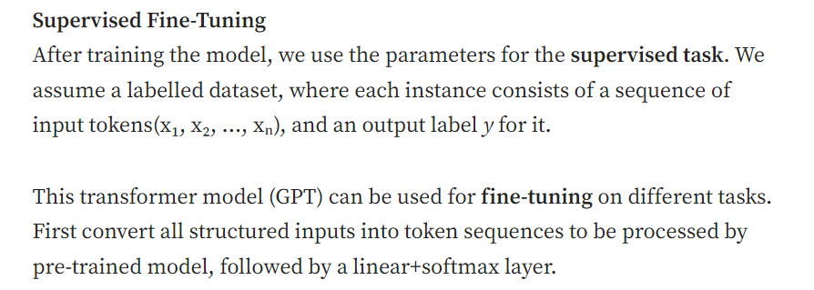
GPT(Generative Pre-training Transformer)

Slide 40
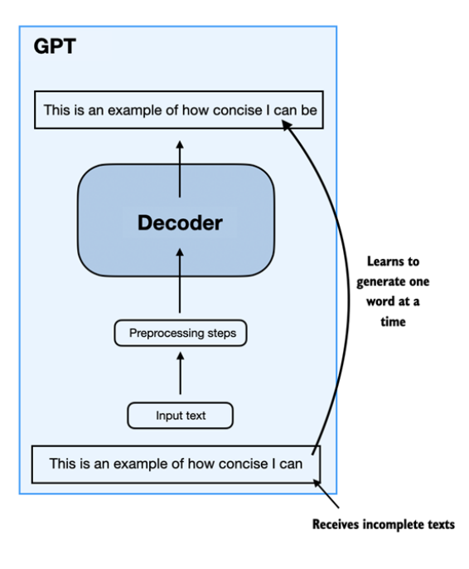
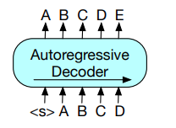
GPT
Generative Pretrained Transformer
GPT is based on the Decoder component of the transformer architecture.
At its heart, the model processes input tokens through multiple stacked transformer layers, each containing self-attention mechanisms and feedforward neural networks
References:
Book: Build a Large Language Model (From Scratch)

Slide 41
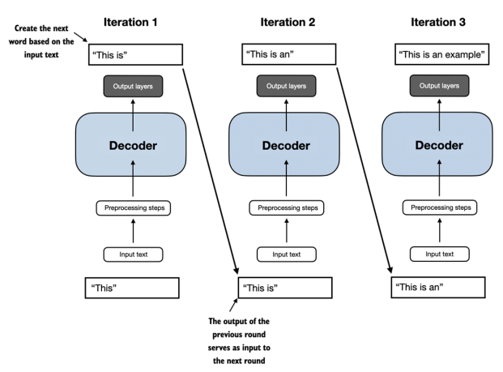
GPT
Generative Pretrained Transformer
GPT is based on the Decoder component of the transformer architecture.
At its heart, the model processes input tokens through multiple stacked transformer layers, each containing self-attention mechanisms and feedforward neural networks
References:
Book: Build a Large Language Model (From Scratch)

Slide 42
GPT
Key Components
Token Processing
When text enters the system, it undergoes two crucial encoding steps:
Token embeddings convert words into vector representations
Positional encodings add sequence information to maintain word order
Self-Attention Mechanism
The self-attention mechanism is what gives GPT its contextual understanding capabilities. It processes input through three main components:
Query vectors
Key vectors
Value vectors
These vectors work together to compute attention scores, allowing the model to weigh the importance of different words in relation to each other
References:
Blog: A Deep Dive into GPT's Transformer Architecture: Understanding Self-Attention Mechanisms

Slide 43
GPT Architecture
Let's take a closer look at the general GPT (Generative Pretrained Transformer).
GPT models are highly capable text completion/generation models.
They can perform a variety of tasks beyond text generation, such as:
Spelling correction
Text classification
Language translation
This versatility is remarkable, considering that GPT models are trained on a relatively simple task: next-word prediction.
References:
Book: Build a Large Language Model (From Scratch)

Slide 44
GPT Architecture
Next-Word Prediction Task
The next-word prediction task is a form of self-supervised learning.
Self-supervised learning is a type of self-labeling where explicit labels for training data are not required.
Instead of manually labeling data, the structure of the data itself is used:
The next word in a sentence or document serves as the label the model predicts.
Advantages of this approach:
Labels are created "on the fly."
Enables the use of massive unlabeled text datasets for training.
This approach allows GPT models to learn from vast amounts of data, improving their performance and generalization
References:
Book: Build a Large Language Model (From Scratch)

Slide 45
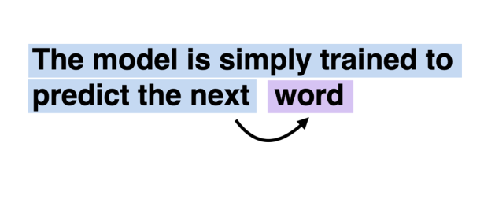
GPT Architecture
GPT Architecture
The GPT architecture is relatively simple compared to the original Transformer architecture (More on this later).
It consists of only the decoder part (more on this in the next section) of the Transformer model, without the encoder.
Key characteristics of GPT architecture:
It is a decoder-style model.
It generates text by predicting one word at a time, making it an autoregressive model.
References:
Book: Build a Large Language Model (From Scratch)

Slide 46
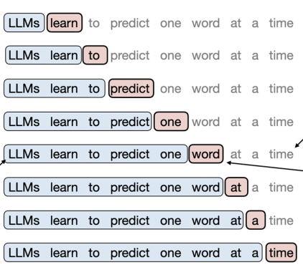
GPT Architecture
Autoregressive Models
GPT models are considered autoregressive because:
They incorporate their previous outputs as inputs for future predictions.
Each new word is chosen based on the sequence of words that precedes it.
This autoregressive nature improves the coherence of the generated text.
References:
Book: Build a Large Language Model (From Scratch)

Slide 47
GPT
Processing Pipeline
Input Processing
The model first tokenizes input text into smaller units and converts them into embeddings. These embeddings then receive positional information to maintain sequence order.
Transformer Layers
Each transformer layer contains:
A multi-head self-attention mechanism
A feed-forward neural network
Layer normalization components
Residual connections
Output Generation
The final layer produces probability distributions over the vocabulary, enabling the model to predict the most likely next token in a sequence
References:
Blog: A Deep Dive into GPT's Transformer Architecture: Understanding Self-Attention Mechanisms

Slide 48
GPT
Generative Pretrained Transformer
Training Methodology
GPT models undergo a two-phase training process:
Pre-training
During this phase, the model learns from vast amounts of text data, developing an understanding of language patterns and relationships.
Fine-tuning
The model is then refined on specific tasks with human feedback, improving its ability to generate contextually appropriate responses

Slide 49
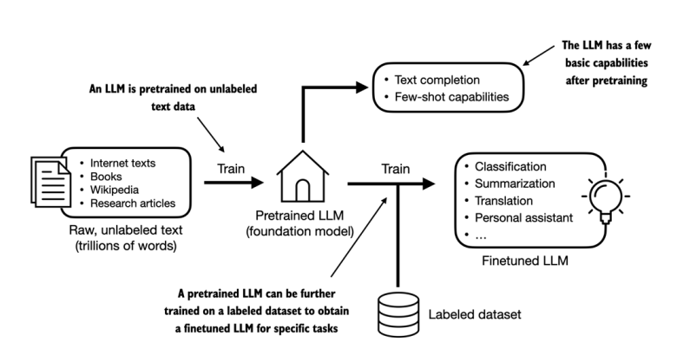
GPT
Generative Pretrained Transformer
Figure: Two Stage Process
References:
Book: Build a Large Language Model (From Scratch)

Slide 50
GPT
GPT models, particularly GPT-3 and GPT-4, are primarily used for generative tasks due to their autoregressive nature. Here are some key applications:
Text Generation:
Task: Generating coherent and contextually relevant text based on a given prompt.
Example: Writing essays, stories, or articles.
Text Completion:
Task: Completing a given piece of text.
Example: Autocompleting sentences or paragraphs in writing applications.
Conversational Agents:
Task: Creating chatbots and virtual assistants that can engage in natural conversations.
Example: Customer support chatbots.

Slide 51
GPT
Language Translation:
Task: Translating text from one language to another.
Example: Translating English text to Spanish.
Summarization:
Task: Generating summaries of longer texts.
Example: Summarizing news articles or research papers.
Creative Writing:
Task: Generating poetry, scripts, or other creative content.
Example: Writing poems or movie scripts.

Slide 52
Thank You!

